Slide 1


SQL Basics
CS3083-B Prof. Arfaoui

Slide 2
Last Time:
DB Design Fine-tuning:
Functional Dependency
Normalization

Slide 3

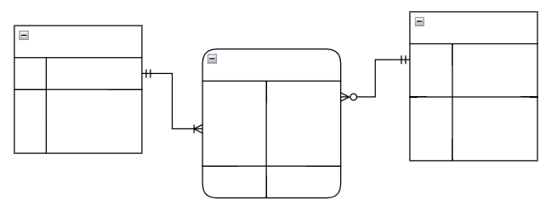


Database Design Process
Interact with stakeholders to characterize the data (requirement specification)
Translate requirements into
conceptual model (E-R diagrams)
Convert the model to relational model
(schema and constraints)
Normalize and develop
conceptual (logical) schema of the database
Implement physical schema
(SQL clauses, partitioning and indexing)

Slide 4
Today: Now that we have schemas and constraints, - How do we implement them? - How do we populate and manipulate them? - What happens when we execute the SQL query?
Overview of The SQL Query Language
Parts of the query language:
SQL Data Definition Language DDL
SQL Data Manipulation Language DML
SQL Data Query language DQL
Additional Basic Operations
Set Operations
[A. Silberschatz, H. F. Korth, S. Sudarshan, Database System Concepts, Ch.3]

Slide 5
Structured Query Language (SQL)
Standard language for relational database managements
Domain-specific language
SQL only works on relational databases
Not for general purpose programming (e.g., Java, C/C++, Python)
Include the ability to process sets of data
Querying data
Controlling access to the database and its objects
Guaranteeing database consistency
Updating rows in a table
Creating, replacing, altering, and dropping objects

Slide 6
QUERY LANGUAGES
Parts of a query language (such as Relational Algebra and SQL) are divided into three main categories:
Data Definition Language (DDL) | Data Manipulation Language (DML) | Data Query Language (DQL)
Effects schema • CREATE TABLE • ALTER TABLE • DROP TABLE | Effects instance • INSERT • UPDATE • DELETE | Effects instance SELECT

Slide 7
Domain Types in SQL
Provides standard type; for example,
Numbers:
INT, FLOAT, DECIMAL(p, s), DECIMAL(p, s)
Strings:
CHAR(n) – fixed length n
VARCHAR(n) – variable length, max length n
TEXT – for large value; not support DEFAULT values, NOT NULL
BOOLEAN
DATE, TIME, TIMESTAMP
DATE – year, month, and day values
TIME – hour, minute, and second values
TIMESTAMP – year, month, day, hour, minute, and second values
More are covered in Chapter 4.

Slide 8
SQL Statements
CREATE TABLE ...
DROP TABLE ...
ALTER TABLE ... ADD / REMOVE ...
INSERT INTO ... VALUES
DELETE FROM ... WHERE ...
UPDATE ... SET ... WHERE ...
SELECT ... FROM ...
... UNION ...
... INTERSECT ...
[ More constraints and referential constraint maintenance later ]

Slide 9
Create Table construct
An SQL relation is defined using the create table command:
create table r (
A₁ D₁,
A₂ D₂,
...,
A_{n} D_{n},
(integrity-constraint₁),
...,
(integrity-constraint_{k}));
• r is the name of the relation
• each Ai is an attribute name in the schema of relation r
• Di is the data type of values in the domain of attribute Ai

Slide 10
Integrity Constraints in Create Table
Types of integrity constraints that we will see today:
PRIMARY KEY (A₁, ..., A_{n} )
FOREIGN KEY(A_{m}, ..., A_{n} ) REFERENCES r
NOT NULL
SQL prevents any update to the database that violates an integrity constraint.

Slide 11
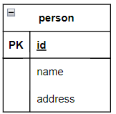
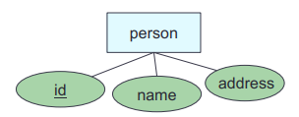
CREATE TABLE (Entity Set)
CREATE TABLE person (
id INT,
name VARCHAR(40),
address VARCHAR(255),
PRIMARY KEY (id) );
person(id, name, address)

Slide 12
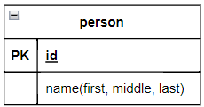
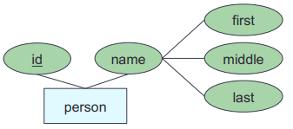
CREATE TABLE (Entity Set)
CREATE TABLE person (
id INT,
first_name VARCHAR(20),
middle_name VARCHAR(3),
last_name VARCHAR(20),
PRIMARY KEY (id) );
person(id, first_name,
middle_name, last_name)

Slide 13
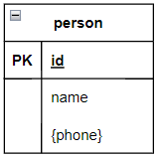
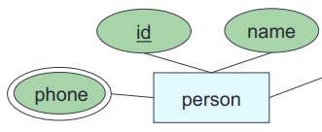

CREATE TABLE (Entity Set)
CREATE TABLE person (
id INT,
name VARCHAR(40),
PRIMARY KEY (id) );
CREATE TABLE person_phone (
id INT REFERENCES person(id),
phone VARCHAR(10),
PRIMARY KEY (id, phone) );
person(id, name)
person_phone(@id, phone)

Slide 14

Let’s Try
Let’s verify that you have access to the DB server and the DB server works properly, and practice writing and interpreting SQL.
1. Start your DB server (or SQL instance)
2. Log in to your DB server (MySQL environment, or your preferred DBMS)
3. Create and Select a DB you want to use
Create a DB:
Use the DB:
4. Create a my_todo table:
CREATE DATABASE my_DB
USE my_DB
my_todo(id, task, priority)
Try to create twice.
What happens?
CREATE TABLE my_todo (
id INT,
task VARCHAR(20),
priority VARCHAR(10),
PRIMARY KEY (id));

Slide 15
INSERT INTO … VALUE
The INSERT INTO statement is used to insert new records in a table.
Syntax:
Example:
INSERT INTO company(cname, address)
VALUES ('Google', '1600 Amphitheatre Parkway Mountain View, CA 94043');
Or
INSERT INTO company
VALUES ('Google', '1600 Amphitheatre Parkway Mountain View, CA 94043');
INSERT INTO table_name (col1, col2,col3,...)
VALUES ( value1, value2, value3,...);

Slide 16
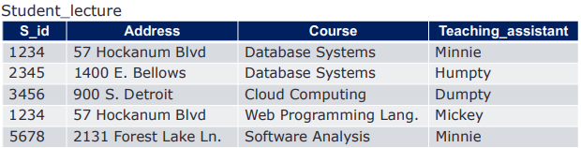
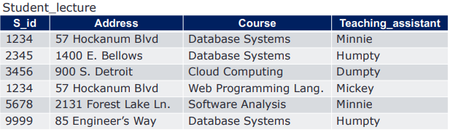
INSERT INTO … VALUE Example
INSERT INTO Student_lecture
VALUES ('9999', '85 Engineer Way', 'Database Systems', 'Humpty');

Slide 17
DROP TABLE
General form:
Example:
DROP TABLE my_todo;
DROP TABLE table_name;
This cannot be undone !!

Slide 18
ALTER TABLE
The ALTER TABLE command is used to modify an existing structure:
Rename a table
Add, delete or modify columns in an existing table.
Add or drop various constraints on an existing table.

Slide 19
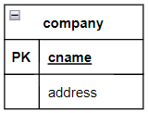
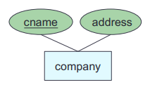
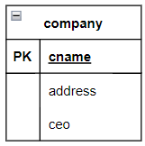
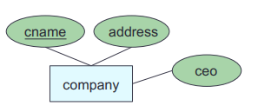
ALTER TABLE … ADD/DROP
CREATE TABLE company (
cname VARCHAR(40),
address VARCHAR(255),
PRIMARY KEY (cname));
ALTER TABLE company
ADD ceo VARCHAR(40);
ALTER TABLE company
DROP ceo;

Slide 20
ALTER TABLE commands (some, not all)
Rename a table: ALTER TABLE table_name RENAME TO new_table_name;
Add a column: ALTER TABLE table_name ADD columnName dataType;
Drop a column: ALTER TABLE table_name DROP COLUMN column_name;
Rename a column: ALTER TABLE table_name RENAME COLUMN old_name TO new_name;
Modify a column: ALTER TABLE table_name MODIFY column_name column_type;
Drop a column: ALTER TABLE table_name DROP COLUMN column_name;
Add a NOT NULL constraint: ALTER TABLE table_name
MODIFY column_name datatype NOT NULL;
Add UNIQUE constraint:
ALTER TABLE table_name
ADD CONSTRAINT MyUniqueCnst UNIQUE(column1,...);
Add a CHECK constraint: ALTER TABLE table_name
ADD CONSTRAINT MyCheckCnst CHECK(condition);
Add a PRIMARY KEY constraint: ALTER TABLE table_name
ADD CONSTRAINT myPKCnst PRIMARY KEY(column1, column2,...);
Add a FOREIGN KEY constraint: ALTER TABLE table_name
ADD FOREIGN KEY (column) REFERENCES table_name(column);
Drop a constraint: ALTER TABLE table_name
DROP CONSTRAINT constraintName;

Slide 21
Let’s continue…

Slide 22
UPDATE … SET ... WHERE
The UPDATE statement is used to modify the existing records in a table
General form:
Example:
UPDATE company SET address = '1600 Amphitheatre Parkway, CA 94043'
WHERE cname = 'Google'
UPDATE table_name
SET column_name = value
WHERE condition;

Slide 23
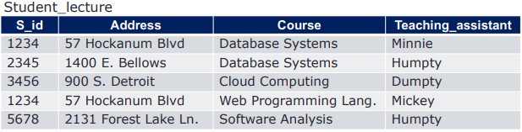
UPDATE … SET ... WHERE Example
UPDATE Student_lecture
SET Teaching_assistant = 'Humpty'
WHERE S_id = "5678";

Slide 24
DELETE … FROM ... WHERE
The DELETE statement is used to delete existing records in a table
General form:
Example:
DELETE
FROM company
WHERE cname = 'Google'
DELETE
FROM table_name
WHERE condition;

Slide 25
Let’s Try (2)
5. Insert data into a table
INSERT INTO my_todo VALUES (99, "read book", "low");
INSERT INTO my_todo VALUES (101, 'do homework 2', "normal");
INSERT INTO my_todo VALUES (212, "write sql", "high");
INSERT INTO my_todo VALUES (114, "practice", "normal");
6. Update data
UPDATE my_todo SET priority="high" where task="write sql";
UPDATE my_todo SET priority="normal" where task="do homework 2";
UPDATE my_todo SET priority="low";
7. Delete data from table
DELETE FROM my_todo WHERE task="do homework 2";
DELETE FROM my_todo;
O
Try to insert twice.
What happen?
What happen?
Oops!!

Slide 26
SELECT … FROM ... (dql)
The SELECT statement is used to fetch data from a database.
A typical SQL query has the form:
• Ai represents an attribute
• Ri represents a relation
• P is a predicate
The result of an SQL query is a relation.
3
1
2
SELECT A₁, A₂, ..., A_{n}
FROM R₁, R₂, ..., R_{m}
WHERE P

Slide 27
SELECT … FROM ... example
SELECT * FROM Student_lecture;

Slide 28
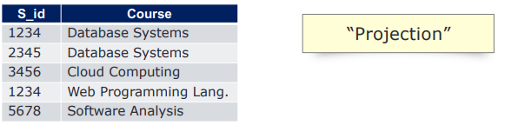
SELECT Specific Attribute
SELECT S_id, Course FROM Student_lecture;

Slide 29

SELECT with WHERE Clause (1)
SELECT * FROM Student_lecture
WHERE Teaching_assistant = “Minnie” ;

Slide 30

SELECT with WHERE Clause (2)
SELECT S_id, Course FROM Student_lecture
WHERE Teaching_assistant = “Minnie” ;

Slide 31

SELECT with WHERE Clause (3)
SELECT S_id, Course FROM Student_lecture
WHERE Teaching_assistant = “Minnie”
OR Teaching_assistant = “Mickey” ;

Slide 32
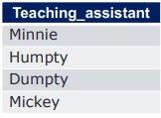
SELECT Distinct
SELECT DISTINCT Teaching_assistant
FROM Student_lecture ;

Slide 33

SELECT with Pattern Matching
SQL includes a string-matching operator for comparisons on character strings.
The operator LIKE uses patterns that are described using two special characters:
percent ( % ). The % character matches any substring.
underscore ( _ ). The _ character matches any character.
SELECT Teaching_assistant
FROM Student_lecture
WHERE Course LIKE 'Data%';

Slide 34
MORE Pattern Matching
SELECT Teaching_assistant
FROM Student_lecture
WHERE Course LIKE 'Data%';
'b%'
→ To find names beginning with ‘b’
→ To find names ending with ‘ty’
→ To find names containing a ‘m’
→ To find names containing exactly five characters
'%ty'
'%m%'
'- - - - -'

Slide 35
Let’s Try (3)
8. Retrieve data
SELECT * FROM my_todo;
SELECT * FROM my_todo WHERE priority="high";
SELECT * FROM my_todo WHERE priority='normal';
SELECT task FROM my_todo WHERE priority="normal";
SELECT * FROM my_todo WHERE task LIKE "%sql" OR priority = "low";
SELECT * FROM my_todo WHERE task LIKE “_ _ad";
SELECT DISTINCT * FROM my_todo;
SELECT DISTINCT priority, task FROM my_todo;
SELECT DISTINCT priority FROM my_todo;

Slide 36
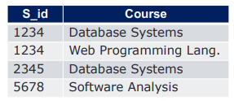
ORDER BY (Ascending)
SELECT S_id, Course FROM Student_lecture
WHERE Teaching_assistant <> “Dumpty”
ORDER BY S_id ASC;
Ascending, by default Or include ASC

Slide 37
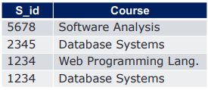
ORDER BY (Descending)
SELECT S_id, Course FROM Student_lecture
WHERE Teaching_assistant <> “Dumpty”
ORDER BY S_id DESC;

Slide 38
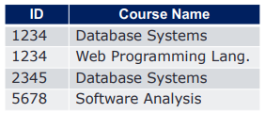
SELECT with Aliases
SELECT S_id as ID, Course as “Course Name”
FROM Student_lecture
WHERE Teaching_assistant <> “Dumpty” ;

Slide 39
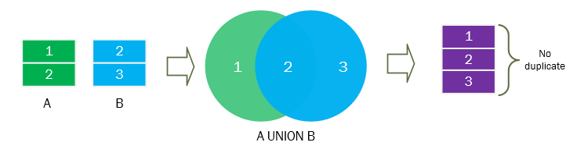
Set Operations UNION
Combine two relations
Each relation must have the same number of columns
The columns must have similar / compatible data types?
The columns in both relations must be in the same order
Tuples of the second relation come after the first
General form:
SELECT ...
UNION
SELECT ...

Slide 40
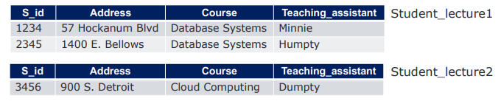
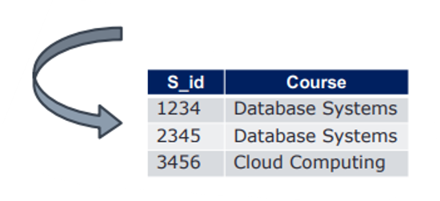
UNION (cont.)

Slide 41
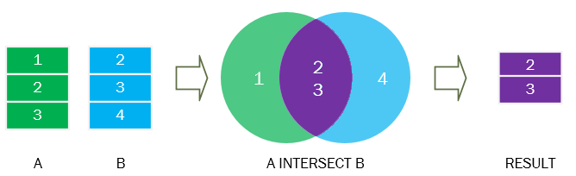
Set Operations INTERSECT
Combine two relations
Each relation must have the same number of columns
The columns must have similar / compatible data types
The columns in both relations must be in the same order
Tuples of the second relation come after the first
General form:
SELECT ...
INTERSECT
SELECT ...

Slide 42
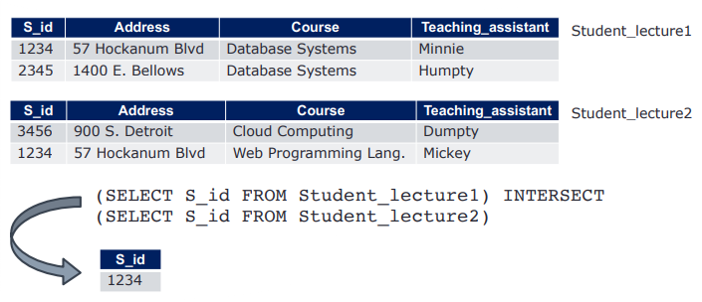
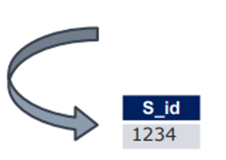
INTERSECT (cont.)

Slide 43
Set Operations EXCEPT
EXCEPT and MINUS are synonymous operators.
Compare the results of two queries.
The columns must have similar / compatible data types
The columns in both relations must be in the same order
Return the distinct rows from the first query that are not returned by the second.
General form:
SELECT ...
{ EXCEPT }
SELECT ...

Slide 44

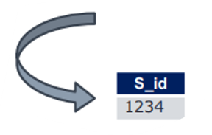
EXCEPT / MINUS (cont.)
EXCEPT

Slide 45
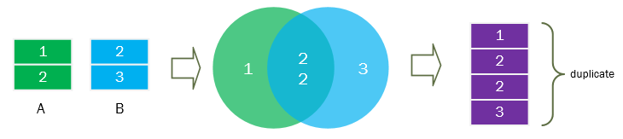

Set Operations retain duplicates
Set operations union, intersect, and except
• Each of the above operations automatically eliminates duplicates
To retain all duplicates, use the
union all

Slide 46
Set Operations INTERSECT
select * from courselist1
UNION
UNION
select * from courselist4;
select * from courselist2
INTERSECT
select * from courselist3;
INTERSECT has higher precedence than UNION and EXCEPT

Slide 47
Next Time .
How do we effectively summarize the results? What is the order of actions? How do we handle "for-each" semantics? Applying the predicates on groups vs. individuals
Aggregate Functions
Group by
Having
NULLs

